Slide 1

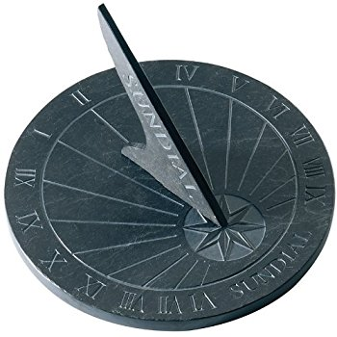
Team 5
Calendar Project
[1]
Progress Report
October 18 2017
Brian Bell
Anhquan Nguyen
Reed Cummings
Alex Lundin

Slide 2
Overview
Acronyms
Functional Requirements
Diagrams
Glimpse at Facebook API

Slide 3
Acronyms
MV Monthly View
WV Weekly View
DV Daily View
Team5 Team name
Cal Proj Short hand

Slide 4
Functional Requirements
1. The create user/registration/log on function will allow people to create new, secure
accounts to be able to use the calendar system and log on after creation.
1.1 The system will allow a user previously not in the system to create a new,
secure account
1.2 The system will need a name, username, and password to create the account
1.3 The system will make sure the username and password meet specific requirements
such as length and exclusion of specific characters
1.4 The system will then save the name, username, and password in a database for
when they try to log on in the future.
2. The MV will show all days in a month, and a snippet for each day
2.1 The system will display the name of the month with a choice to go forward
and backward through months
2.2 The system will display each day of the week at the top of the screen, under
the name of the month
2.3 The system will display each day of the month(number) in accordance to which day
of the week it is
2.4 If a specific date has an event, the system will show the name of the event in
the box designated for the specific day.
2.5 Event alert (optional)
2.6 Add and delete event categories (meeting, due date, ect.)
2.7 Color Marking for different category of events (red, blue, ect.)

Slide 5
Functional Requirements
3. The WV will show all days in a week, snippet for each day
3.1 The system shall display the month followed by the week at the top of the screen
(i.e September 3 - 9), with a choice to go forward and backwards through the weeks.
3.2 The system shall display each day of the week, in accordance to the specific week.
3.3 If a specific date has an event, the system will show the name of the event in the box
designated for the specific day.
4. The DV will show all the events in a day, sorted by starting time
4.1 The system will display the month and day at the top of the screen.
4.2 The system will display one hour time intervals in terms of AM and PM times.
4.3 If the date has an event, the system will show the name of the event in the specified time.
It will also shade a portion of the time intervals to give a visual representation of the
event time duration.

Slide 6
Functional Requirements
5. Adding an event
5.1 The system will display an option to click to add an event.
5.2 The system will ask for an Event Name.
5.3 The system will ask for a starting and ending time.
5.4 The system will ask for times at which the user wishes to be notified of the event. (optional)
5.5 The system will display an option for finishing an event.
5.6 The system will then update the event to all views of the calendar.
5.7 If there is a conflict in time, there will be given a notice about overlapping times.
5.8 The system will ask if the user would like to make the event a weekly event or monthly event.
If yes, then the system will make the same event on the same day of the week or on the same day of the month for the calendar.
5.9 The system will have preset event categories to the system and will be indicated by color
5.9.1 Meetings will be blue.
5.9.2 Due Dates will be red.
5.9.3 Birthdays will be green.
5.9.4 National Holidays will be orange.

Slide 7
Functional Requirements
6. Deleting or editing an event
6.1 The system will give an option to modify and event. It will ask if you would like to modify or
delete the event.
6.1.1 If the user chooses to modify the event, the same menu options as adding an event will be given.
6.1.2 If the user chooses to delete the event, the event will be deleted from all views of the
calendar.
6.1.3 If the modified or deleted event is repeated, the user will be asked whether changes should be applied to future instances of that event. (optional)
7 Special Events
7.1 The system will use all the same functionality as regular events
7.2 The system will use a reserved color
7.3 The system will show an image on monthly and weekly view (optional)
8 Share Event (optional)
8.1 The system will create a bundle of the event information
8.1.1 The system will use standard JSON format, which allows other API's to use the data
8.2 The system will have a 2 step verification process for receiving events
8.3 The system will not allow indirect shares
8.3.1 Only the user who creates the event can share

Slide 8
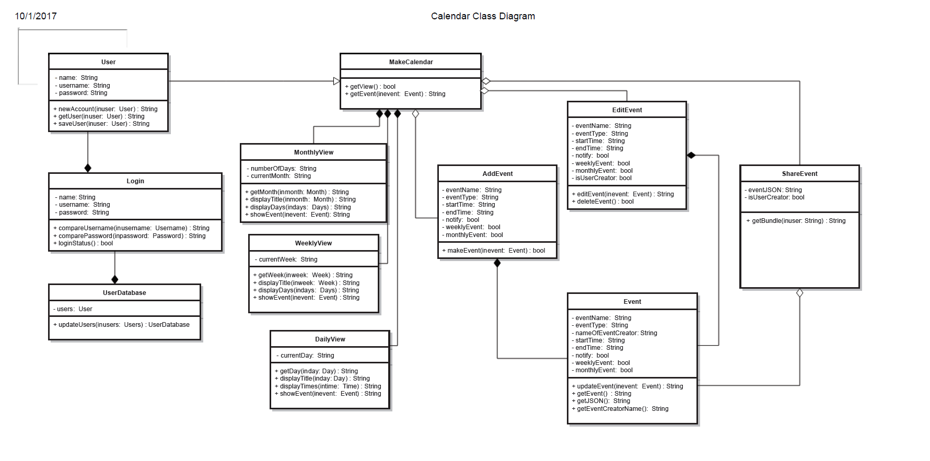
Class Diagram

Slide 9
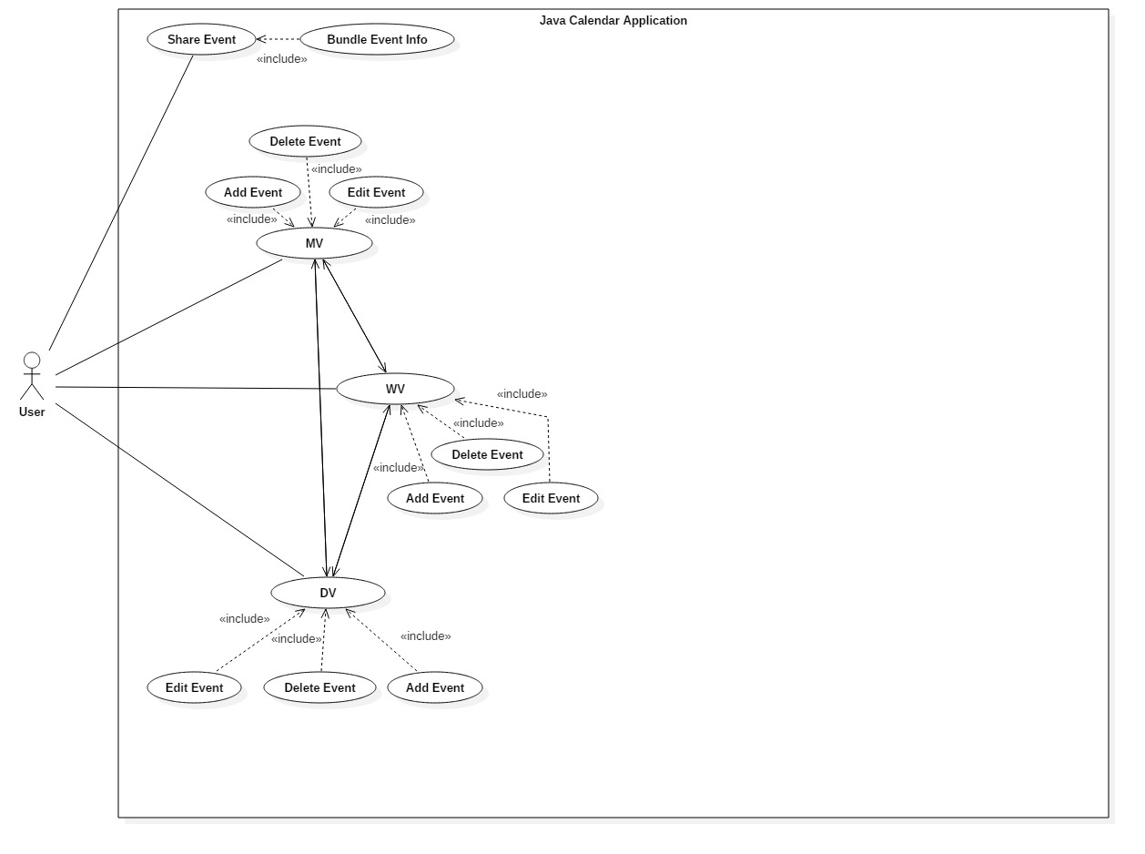
Use Case Diagram

Slide 10
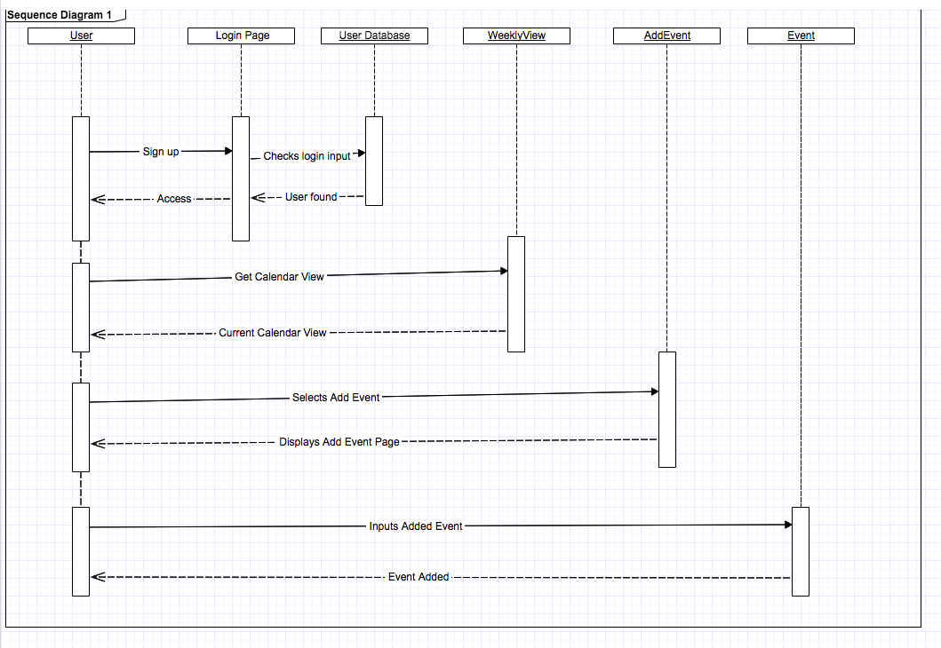
Sequence Diagram 1

Slide 11
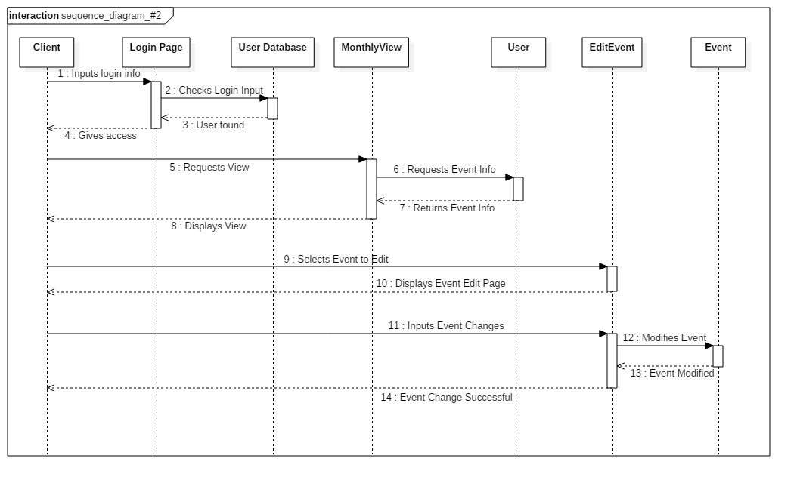
Sequence Diagram 2

Slide 12
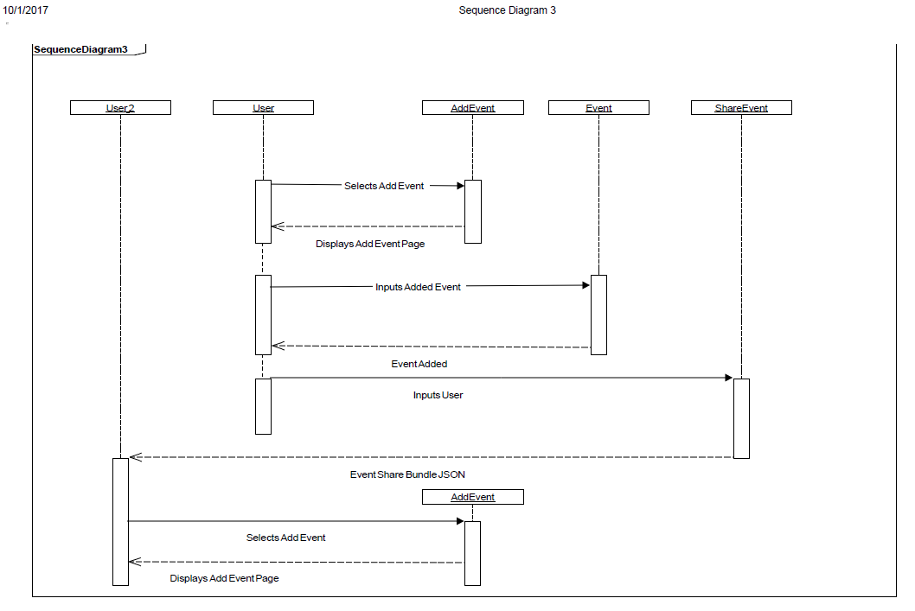
Sequence Diagram 3

Slide 13
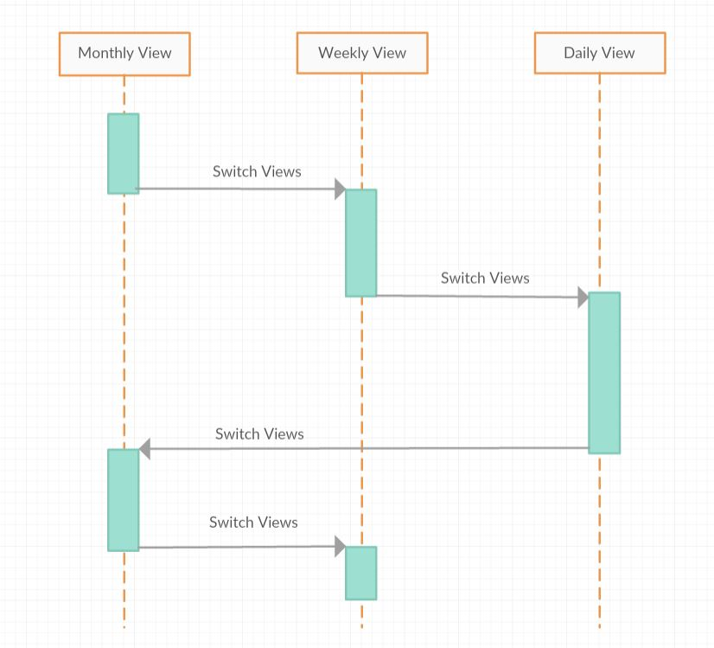
Sequence Diagram 4

Slide 14
Facebook API
Under construction

Slide 15
References
[1] [Online], available at: https://images-na.ssl-images-amazon.com/images/I/51Jl8PdOvML._SL500_AC_SS350_.jpg [Accessed 16 Oct. 2017]

Slide 16
Contact Info
Brian Bell
  Major
  Year
  email@utdallas.edu
Anhquan Nguyen
  Major
  Year
  email@utdallas.edu
Reed Cummings
  Major
  Year
  email@utdallas.edu
  Alex Lundin
  Software Engineering
  Junior
  AML140830@utdallas.edu

